Slide 1
Microsoft Remote Build Execution Dev Speedup with Non-Hermetic Build Engines
AnyBuild
Erik Mavrinac
Microsoft One Engineering System
October 1, 2019

Slide 2
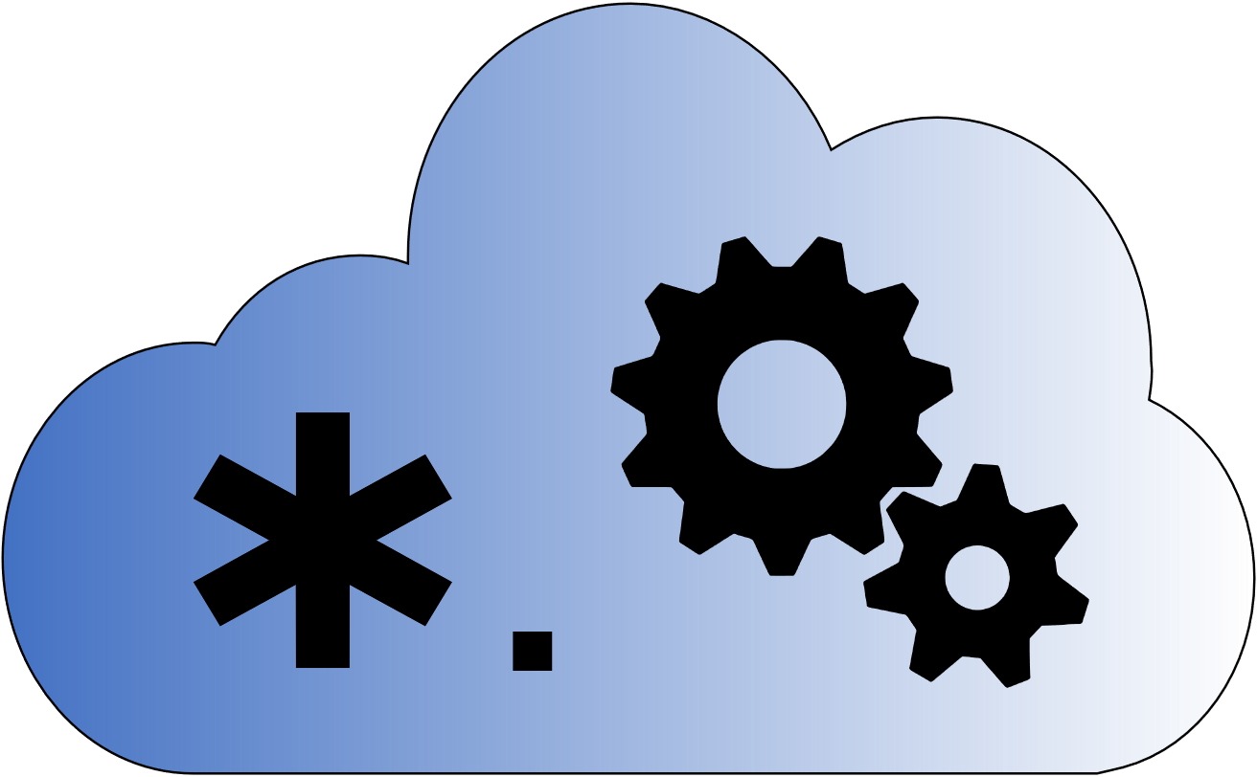
Talk Overview
Background, motivation & challenges
The AnyBuild approach
First results
Internals
Roadmap

Slide 3
Microsoft Cloud Based Build
CloudBuild and QuickBuild – 2011
Started as a stack of machines under a dev’s desk, migrated to datacenters
Allow distributing MSBuild and the 1989 NT nmake build system
Bing: 10-hour retail builds ➔ 1 hour, 6-hour debug builds ➔ 16 minutes
Caching came later to make 1-minute builds common
Batch build system – push branch, request build, wait, maybe download drop or use in downstream test and deployment infra
Build Accelerator (BuildXL) – 2013
Initially based on Bazel pattern of complete input, output specs
Windows and Office first – the largest codebases in the company at 250-500 GB
Open source in early 2019, MSBuild support in 2018, converging with QuickBuild slowly
CloudBuild builds thousands of repos from a few megs to ½ TB
400K builds/week on >35,000 physical machines

Slide 4
The Basic Premise of Remote Execution
RE extends a build machine’s capabilities
More CPU cores (and GPUs if that’s your need)
More memory
Most importantly: More I/O buses and disks
Most conventional build tools are I/O-heavy
But has costs in terms of cloud compute, plus latency and overhead per remoted command moving data back and forth
Trade compute cost for overall developer time and productivity
Example from one 75-person internal team: Reduction by half of build time on longer desktop builds can save 9500 hours/month
Plus reduces or delays the need for devs to spend time optimizing build logic

Slide 5
Challenges for Remote Execution (At Microsoft and In General)

Slide 6
The RE Agent Tool Installation problem
Chasing the latest that devs are using is not fun
What about this SDK? This tool? This package? This admin-installed product (Docker)?
VM/container image management is a chore
Patching (of course)
Union of all tools needed by all devs X repos
Example: Azure DevOps Pipelines has an image line for Windows Server 2019 that is constantly updating with new Docker, Visual Studio, MSBuild, NodeJS, Python 2, Python 3, Windows SDK, …

Slide 7
The Build Language Problem (Not Just for MSFT)
We can’t bring everyone to Bazel
Millions of lines of build code across thousands of repos, inside and outside MSFT
MSBuild ecosystem: Hundreds of thousands of devs including in Visual Studio, VSCode
Changing build language is not normally a key business need – dev team speedup usually not sufficient to prioritize over customer-facing features and fixes that improve revenue or save costs
This is less true the more massive the codebase and the more pain the devs feel
So mid-sized repos’ devs feel it the most
Changing build language introduces build, test, deployment bugs that can be time consuming to figure out
Dev retraining to a new build language is a significant human and org cost
We need to bring RE to where the devs are
I would use Bazel in a new startup – knowing what happens when your code grows over time
Notes:
Said a large team circa 2013: We’ll take 2000 devs for a month and convert 125,000 build specs to a new language. Actual number converted: 0. Sanity prevailed.

Slide 8
The Build Engine Nondeterminism Problem
Example: Gulp – build engine as JS code execution
Good luck modeling all the inputs and outputs to get hermeticity!
Example: MSBuild – underspecified, ProjectReference not even a top-level graph concept yet
Like Make: filesystem datetimes as a state database, plus in-memory properties
MSBuild Project Graph feature underway to improve this
Chasing these engines to wrap caching and distribution around them is expensive
Over 8 years chasing MSBuild so far in QuickBuild
Creating inputs/outputs knowledge is hard, always breakable by the next thing you don’t understand

Slide 9
The Build Tool Path Reliance Problem
The conversion of tools to the Repeatable Builds pattern is far from complete
GUIDs and timestamps are only part of the problem, substantially solved with the right newer tool flags
If teams decide to use the flags… they are off by default
Some outputs end up with absolute paths in them that affect downstream debugging or outputs

Slide 10
The Enlistment Problem
In QuickBuild, BuildXL builds we mostly use real enlistments
Virtual Filesystem for Git (fka GVFS) for Windows repo (currently)
Pull packages before build
Every build machine in a session synced to the same commit and packages
Same pre-loaded view of the filesystem
Maintaining 100K’s of enlistments to avoid up to 4 hours of re-pulling per build is one of CloudBuild’s value adds
Aided by physical machines, full machine reimaging is a low %/day
Maintaining enlistments on non-durable VMs is harder
And if you have lots of customers that’s a lot of disk space to maintain

Slide 11
The Batch Build ProblemPattern
CloudBuild is a massive batch build system
Rolling builds, PR iteration builds, on-demand buddy builds are focus
Dev machines are fat clients typically
No strong virtualization story outside of VFS/GVFS, not for lack of trying
Individual devs sometimes use QuickBuild or BuildXL dev cache read from datacenter outputs
But if you change sources or packages locally, no dev cache matching
Good luck being the dev upgrading packages or making a large refactor!
We use lots of buddy builds in the datacenter when doing this
Minimal integration with Visual Studio – the company tool of choice*
QuickBuild rolling out an extension to try populating disk with dev cache outputs
(*) 75% of dev-hours inside the company spent in VS, next in VSCode

Slide 12
The AnyBuild Approach

Slide 13
What If…
We let an existing build engine just do whatever it wants to do locally with filesystem timestamp or hash based incrementality etc.
But we watch what it decides to do and remote things selectively
And we can remote on minimal agents that don’t need to have enlistments, packages, or Ʃ(tools) installed
And we ensure that tools that rely on absolute paths still work seamlessly
… And we focus on dev local inner loop first, lab/datacenter builds later

Slide 14
Microsoft AnyBuild Remote Execution
Client can wrap an existing build engine and hook process creation, or add RE as a library (e.g. to BuildXL, QuickBuild)
Client can choose to remote based on current machine state, policies, historical knowledge, agent availability
Client and agent CAS are central to system similar to Bazel Remote Exec
Uses same upload/download gRPC protocol
Agents are minimal images with no toolsets installed, Win10 1903+ kernel
Filesystem virtualization and BuildXL sandboxing virtualize client-side drives and paths, including tools, sources, packages
Tools see client paths, no difference from running at client
New: Agent can reach back to client to pull missing directories and files dynamically
Non-hermetic predictions are slower instead of failing

Slide 15
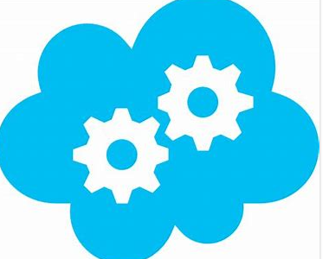
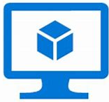


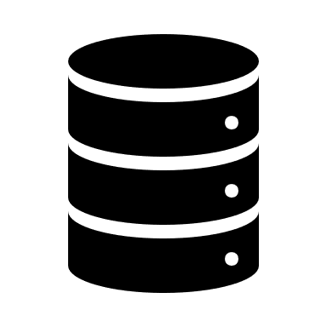
High Level How-Does-It-Work?
Dev Desktop/Laptop
Remote Build Execution Service
Remote Build Execution client
Lives within your regular build command
Integrated update mechanism
Sends telemetry to service
Agent Coordinator intelligently allocates VMs (number + size) to optimize build time & distributes build tasks among VMs
3. Copy delta of files to build in cloud
VMs run the required build tasks in parallel, leveraging the CAS
1. Dev initiates local build command (the same they normally use)
2. Remote Build Execution Client analyzes which build tasks to offload
4. Copy offloaded build outputs
CAS manages the cache of previous build inputs and outputs
5. Merge build results (re-use from cache when possible)
CAS store contains the previous build inputs and outputs
If service is unavailable, local build works transparently

Slide 16
First Results

Slide 17
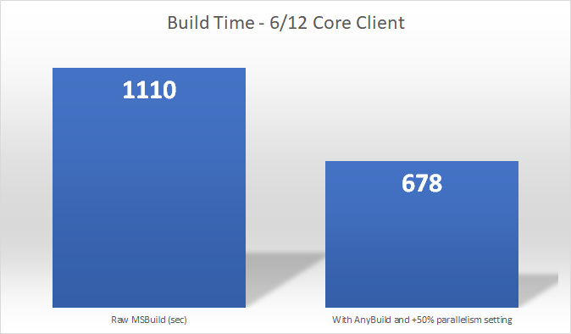
Beefy desktop – 8 minutes saved of 18.5

Slide 18
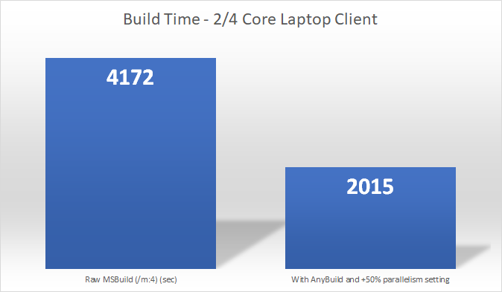
Laptop – 36 of 70 minutes saved

Slide 19
Details
6/12 core: Desktop dev machine, 64GB mem, M.2 SSD
2/4 core: Laptop, 16GB mem, SSD
Internal C++-heavy mid-sized repo
500 MSBuild projects, 300 vcxproj (C++)
25 build agents plus service coordinator VMs in shared 96-core team deployment with from 2 to 16 cores per agent
Azure D2 v2 generic caompute VMs preferred for agents
v3 would be less expensive per core but less capable, temp drive is too small on 2-core SKU
Deployment would cost ~$2K/month in VM time running only during business hours (50 hours/week) assuming full retail metered VM billing
cl.exe (compiler) remoting only
Debug full build with no LTCG linking
MSBuild parallelism settings at +50% meaning /m:18 for the 6/12 core and /m:6 for the 2/4 core
AnyBuild MinParallelism=4 to remote only larger compilations (4+ cpp files)

Slide 20
Internals

Slide 21

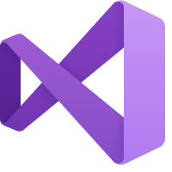

AnyBuild Agent
Visual Studio
Compiler
AnyBuild Sandbox
MSBuild
AnyBuild Agent
robocopy
VSTest
Remote Shim
exe
VSTest
Remote Shim
exe
Compiler
Local Disk
Notes:
Narrator: Let’s say you’re using Visual Studio for your project. <tap>
You’ve installed Microsoft AnyBuild and you hit F6 to build and test. <tap>
You are using MSBuild as your build language. <tap>
We wrap MSBuild in an AnyBuild execution sandbox <tap> to intercept MSBuild’s actions. MSBuild proceeds to run all of its usual tool chains<tap>, including incrementalism derived from timestamps and other information on disk.
Let’s say MSBuild decides to run an external process <tap> like a compiler.
AnyBuild sees this action and inserts <tap> a proxy process. The command line, environment, and current working directory are <tap> passed to AnyBuild.
AnyBuild predicts file and directory inputs and determines that this process is worth remoting. <tap> AnyBuild gets an available build agent from the cloud, and <tap> tells it to run your process. AnyBuild caching technology uses petabytes of cloud storage to cache every source code file, every package, and every app that your repo uses, so that we only upload the very latest files you changed on your dev machine.
<tap> We cache the outputs in the cloud, then pull them back to your dev machine, <tap> and place them on your hard drive just as though the results were run locally. Then we release MSBuild to keep processing. <tap>
When an Azure AnyBuild agent is not available, or for processes that <tap> require far more I/O than CPU power, AnyBuild can <tap> run the process locally.

Slide 22
ProjFS, BindFlt Win10 Drivers and BuildXL Sandboxing
ProjFS (PrjFlt driver) is from Win10 1607 (RS1) release
Underpins the Virtual Filesystem for Git (fka GVFS)
Incremental virtual filesystem rendering using placeholders, dir+file callbacks
We use it to virtualize all client drive letters and paths on agent
Dir, file callbacks resolved from CAS or paused to get from client if nothing from predictions
BindFlt allows selective kernel-level remapping of directories – new in Win10 1903 (RS6)
We use BindFlt to snip out the virtualization working directory on the agent and ensure that calls into Windows APIs are from agent machine
We run the command under mature BuildXL Detours logic that watches filesystem API calls to find build inputs and outputs
Outputs used to fill CAS and return to client

Slide 23
Azure Deployment Architecture
Agents are VMs, not containers
ProjFS, BindFlt need admin
Azure VM Scale Sets make for easy scale up/down
Agents are reused between commands but are team or org specific
AgentCoordinator service provides agent lists to clients within shared pool
Agents currently use direct IPs, clients move on if agents are busy
Intent is to move to a centralized service proxy like RE over time
CosmosDB, Redis, Blob Storage, KeyVault underlie these pieces

Slide 24
Remote Execution Protocol Usage
We are based on Bazel RE for low level currently, more as time allows
By service interface:
ByteStream: 95%
CAS: 80%
Capabilities: 0%
ActionCache: 0%
Execution: 0%

Slide 25
Specialized Execution gRPC call
2-way server<->client
Stdout, stderr outputs are interleaved for higher fidelity output
Agent can reach back to client to get directory metadata, file hashes, file contents not predicted by client
This is how we handle nondeterminism and optimism failures in CAS
E.g. #include “..\inc\foo.h” not found in command prediction or other data will result in slowness but not failure
We can take specific misses and feed back to users in a UX if we know it’s something they need to add metadata about. “Your build would be faster if you added <ClInclude>..\inc\foo.h</ClInclude> to bar.vcxproj”

Slide 26
Content Addressable Store
Implementation uses the tiered local and peer-to-peer BuildXL cache system
No “backdrop” layer currently since we can always get files from client
gRPC between machines
Redis as replica tracking store
Layered metadata database state caches (“LLS”) in between
Client has a local CAS for build output caching
Since we can call back to dynamic file retrieval from client, CAS can be best-effort optimistic within reason

Slide 27
Roadmap
Shipping internally to first customer in late October
More internal customers already lined up – MSBuild, Gulp
BazelCon (Dec 2019) timeframe: First trivial Bazel build against Agent
Vanilla Bazel RE protocol support under development now
Going fully open source in next few months: https://github.com/Microsoft/AnyBuild
Aiming for enlist, build, deploy, install client in 30 minutes for a new team
Speedup noticeable soon after
link.exe with LTCG and other commands being added
Might propose 2-way agent contract as an RE protocol extension
Possible integrations next year: BuildXL, QuickBuild, Azure DevOps Pipelines

Slide 28
AnyBuild: https://github.com/Microsoft/AnyBuild
BuildXL: https://github.com/Microsoft/BuildXL
MSBuild: https://github.com/Microsoft/MSBuild

Slide 29


